Slide 1
Case Studies on Solidarity /Equity
By: Shashank
Divya
Vedant

Slide 2
Equity Defined Based on Both Theories:
Aristotle's approach: Adjusting treatment or resources within a decision process based on the differences between individuals, ensuring fair opportunities.
Rawls' approach: Ensuring that the least advantaged in society benefit the most from social and economic arrangements, focusing on outcomes that improve equity across the broader system, promoting inclusiveness and social justice.
In essence, equity is about fair treatment based on need and circumstance (Aristotle) while also striving for fair outcomes that uplift the least privileged (Rawls). It balances fairness in both the process and outcome, ensuring that no one is left behind and that individuals are treated according to their specific context and needs.

Slide 3
Case Study 1: AI-Powered Healthcare Diagnosis Tools
Problem Statement:
In a resource-constrained healthcare system, AI tools are introduced to assist doctors by making initial diagnoses based on patient data (symptoms, medical history, lab results). These systems aim to optimize time and resources while ensuring patients receive accurate medical advice. .
Identify the Ethical Dilemma
The AI system is trained on historical patient data, which may reflect biases in past medical diagnoses (e.g., misdiagnosis rates may be higher in minority groups). While AI could enhance diagnostic accuracy and reduce workload, it risks reinforcing these biases, leading to unequal healthcare outcomes.

Slide 4
Predict the Outcome
Doctors increasingly rely on AI to make decisions, which could lead to faster treatment, but for patients from minority backgrounds, AI may perpetuate historical biases, resulting in worse health outcomes. This raises fairness and justice concerns.
Identify the Objection
Critics argue that while the AI tool creates the appearance of improved efficiency and fairness (everyone is diagnosed by the same model), it may actually deepen inequalities. People in historically marginalized communities may receive lower-quality diagnoses because the AI's training data reflects past human biases.

Slide 5
Ethical Considerations
Bias in Data: AI diagnosis tools may reflect systemic biases, especially if the historical medical data used in training is skewed.
Fairness: Patients with similar symptoms may receive different recommendations based on biased data. Does this violate principles of healthcare equity?
Transparency: AI tools are often black-box systems, making it difficult for doctors or patients to understand why certain decisions are made.
Possible Solutions
To address these concerns:
Diverse Data Training: Ensuring AI models are trained on diverse datasets to reduce bias.
Human Oversight: Doctors should use AI as a tool, but final decisions must rest with human professionals, ensuring that individual patient needs are met.
Regular Audits: AI systems should be subject to ongoing audits to detect and mitigate biases.

Slide 6
Fairness Approach:
Problem: A fairness-driven approach would ensure that the AI system applies the same criteria to all patients, treating everyone equally. However, fairness in this context may unintentionally reinforce inequity because it assumes all patients have the same healthcare needs and historical treatment.
Outcome: Under a purely fairness-based approach, the system would apply the same diagnostic criteria to all patients, even though doing so ignores the unique healthcare challenges faced by different racial or ethnic groups. While the AI system would be "fair" by applying the same process to all, it would still produce biased outcomes for underrepresented groups.
Could Computers Help Solve the Problem?
AI can contribute by flagging outlier cases where biases might appear, offering a second opinion that encourages human doctors to take a more thorough approach to marginalized patients. The technology’s role becomes one of augmenting human decision-making rather than replacing it.

Slide 7
Case Study 2: AI and Automated Hiring Systems
Problem Statement:
A large company implements an AI-driven hiring system that screens resumes and predicts candidate success based on historical hiring data. This is done to streamline the recruitment process and ensure objectivity in selecting candidates.
Identify the Ethical Dilemma
The AI system is trained on past hiring decisions, which may reflect unconscious biases in race, gender, or educational background. It prioritizes candidates from prestigious schools or specific regions where the company has historically hired from, systematically disadvantaging others.

Slide 8
Predict the Outcome
While the AI is efficient and objective in appearance, it unintentionally perpetuates systemic discrimination, favoring candidates from elite backgrounds and excluding qualified candidates from underrepresented groups. The company's workforce diversity suffers as a result.
Identify the Objection
Critics argue that the use of AI in hiring creates an illusion of fairness (since it is algorithmic and neutral) but in reality, it excludes diverse and qualified candidates. This approach may entrench social inequities by favoring candidates with privileged access to education and resources.

Slide 9
Ethical Considerations
Bias in Algorithms: AI hiring tools can reinforce stereotypes and perpetuate inequalities if the training data reflects biased hiring practices.
Fairness: Is it fair to exclude candidates who may be highly capable but lack traditional indicators of success, such as prestigious educational backgrounds?
Accountability: Who is responsible if the AI system makes an unfair hiring decision? Should the company or the AI vendor be held accountable?
Possible Solutions
To address these objections:
Inclusive Data: The AI model should be trained on more diverse hiring datasets, ensuring that it considers a wider range of qualifications.
Human Review: After initial screening by AI, human recruiters should review diverse candidates, balancing efficiency with fairness.
Transparency: The AI system’s decision-making process should be made transparent to ensure candidates understand why they were selected or rejected.

Slide 10
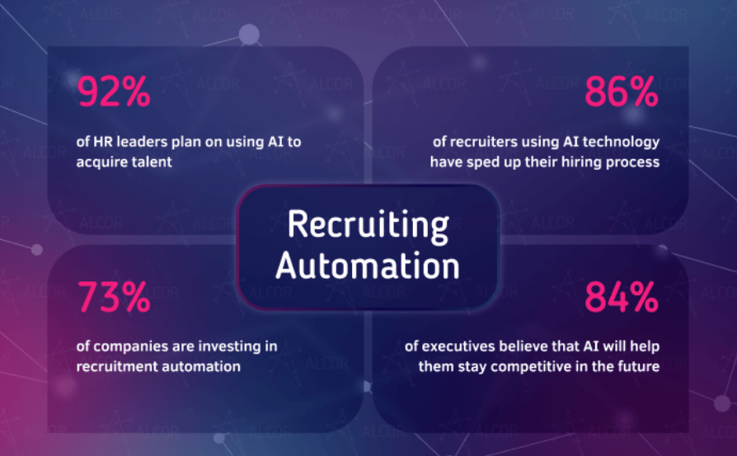
Fairness Approach:
Problem: A fairness-based approach would apply the same hiring criteria uniformly to all candidates. However, this method ignores the fact that not all candidates have the same access to education and opportunities, and as such, this ‘fair’ process would likely still favor those from more privileged backgrounds.
Outcome: A purely fairness-based AI hiring system might be consistent in applying rules but would fail to correct underlying social inequities, continuing to favor elite candidates over those from disadvantaged backgrounds.
Could Computers Help Solve the Problem?
AI can help by detecting patterns of bias within the hiring process itself. For example, AI could analyze which groups are being unfairly excluded and suggest adjustments to hiring criteria. It can also be designed to weigh non-traditional qualifications, such as skills-based assessments, alongside traditional markers like education and experience.

Slide 11
Summary:
Both cases emphasize the tension between efficiency, fairness, and historical bias when using AI systems.
Ethical concerns revolve around fairness, transparency, accountability, and the need to address systemic inequities embedded in data.
Computers can help address these concerns, but human oversight, diversity in data, and continuous ethical reflection are essential to ensure AI contributes to solidarity and equity.

